Slide 1

Team Farthorl
Advanced C# May 2016

Slide 2
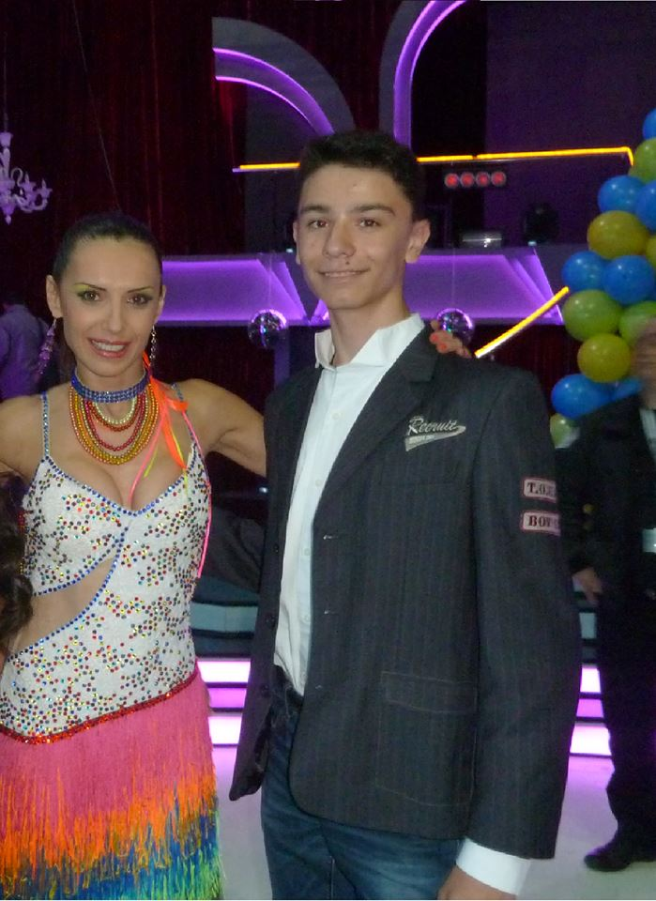
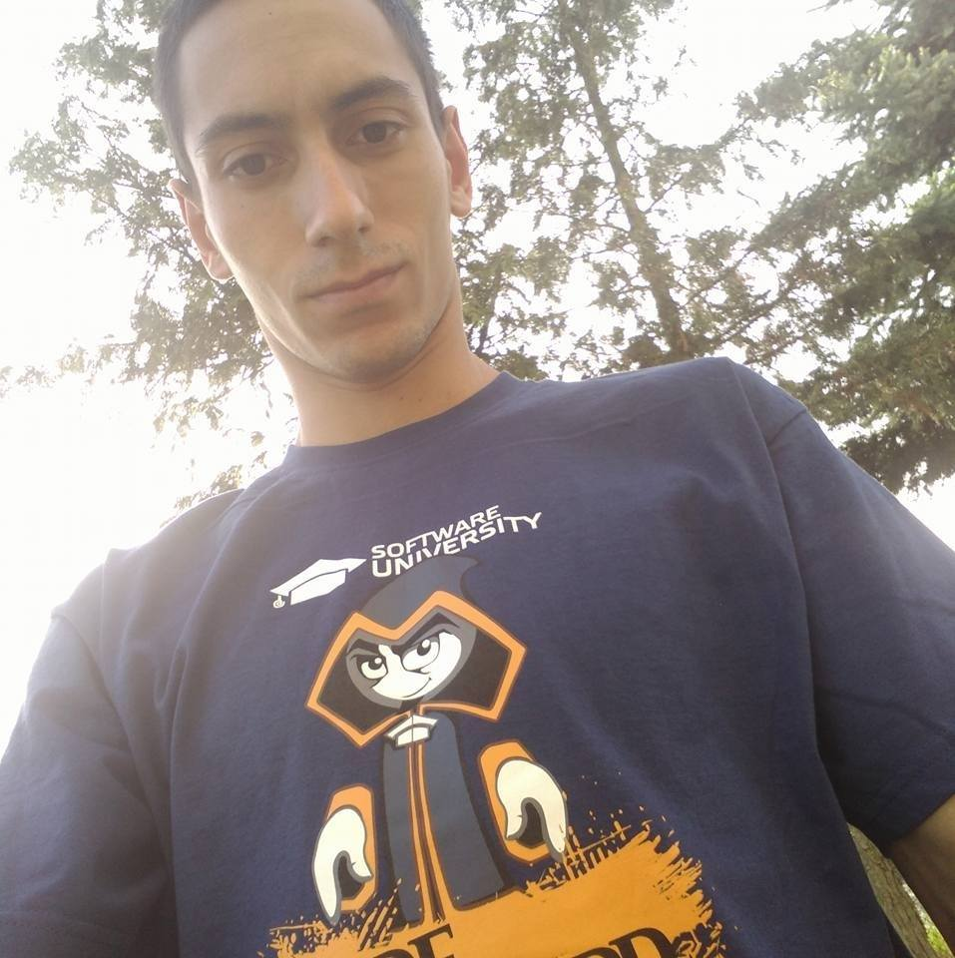








Team Members in alphabetical order :D

Slide 3

Short Pacman history:
One of the most iconic
games of the 80s, developed
By Namco
Environment with a maze,
filled with dots & fruits
Pacman eats the dots for points
Ghosts are agents that chase Pacman
When Pacman eats a fruit,
he can eat the agents

Slide 4
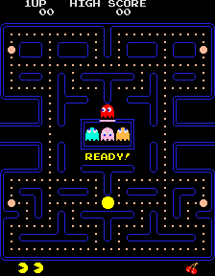
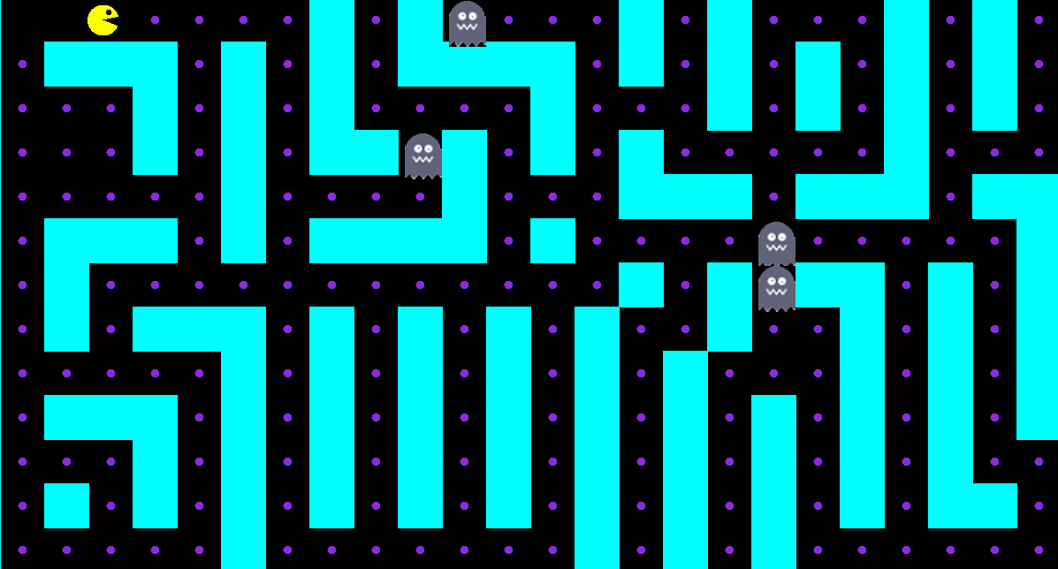
Basic Game Concept
Before - 1980
After - 2016

Slide 5
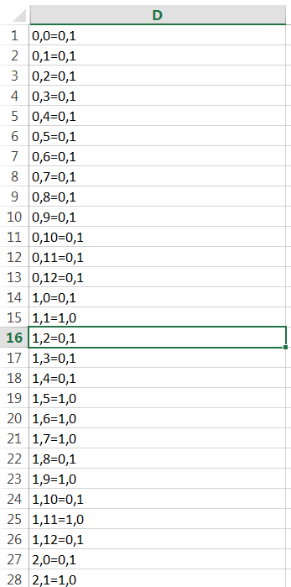
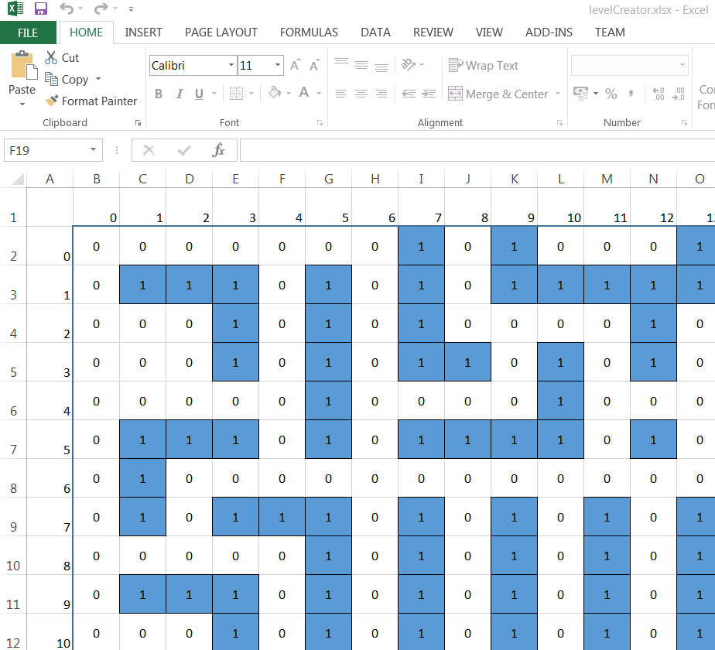
User Friendly Level Generator

Slide 6







(Original) Pac-Man Sounds Click the speaker to hear it’s sound
Ready!
Intermission
Eating Dots
Eating Ghost
Eating Fruit
Extra Life
Death

Slide 7
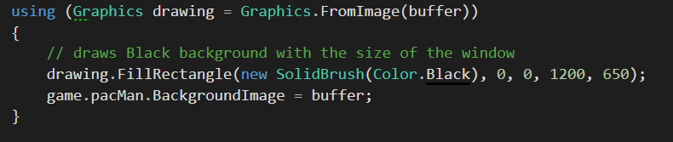
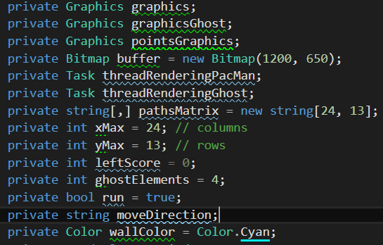
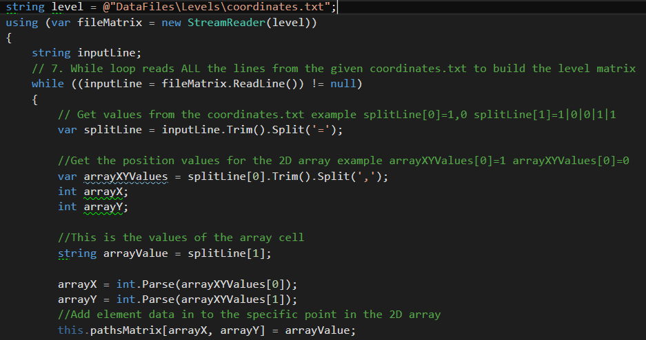
Code Logic Overview
Engine:
Using System.Drawing;

Slide 8
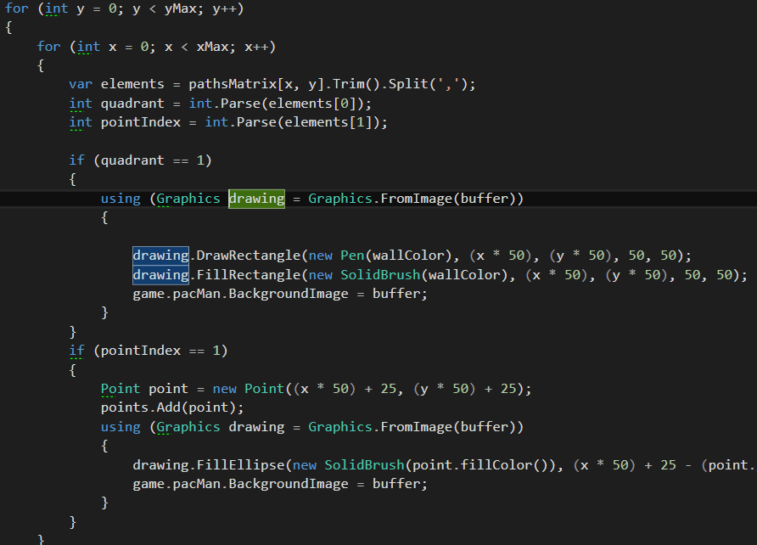
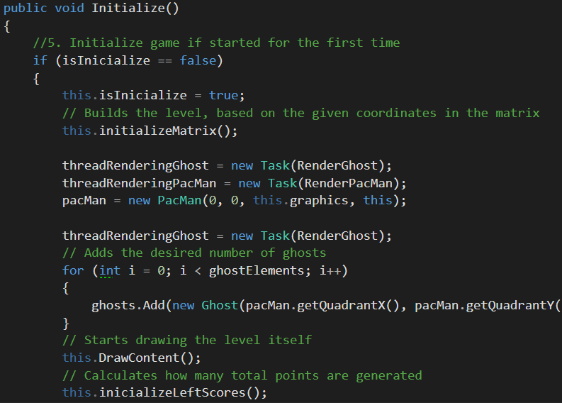
And the drawing continues…

Slide 9
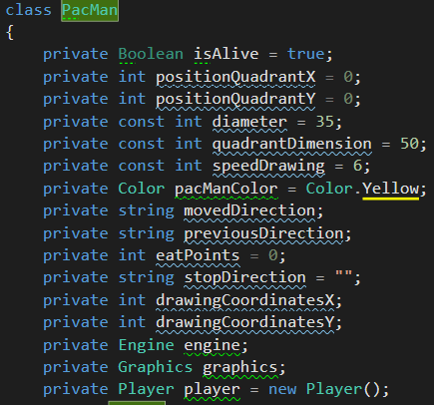
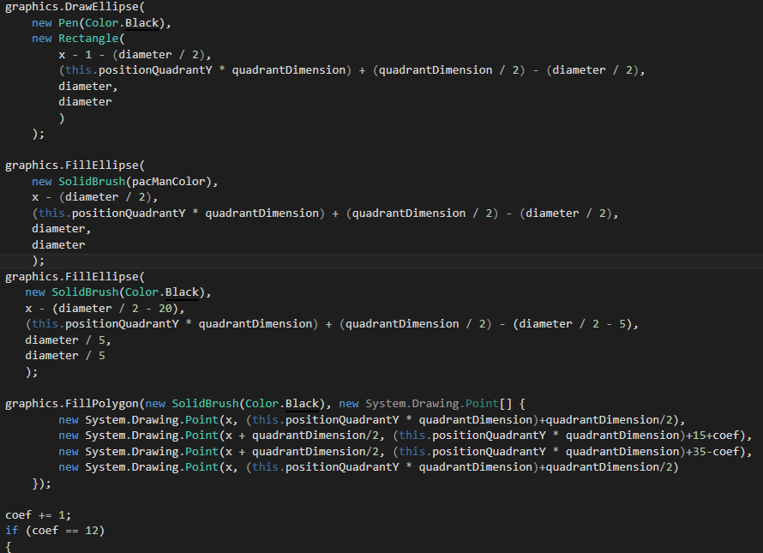
The one and only… Pacman!
P.S. This guy over here

Slide 10

Planned features in the future
Fruits can have random side effects, including :
Stopping the Ghosts for a while
Decreasing Ghost speed
Increase Ghost Population
Increase Ghost Speed
Reverse your keyboard keys!
Teleport you to a random location
+ More Levels
+ More Sounds
+ Interactive Menu
+ Increased Difficulty Mode with imporoved Ghost Pathfinding
+ If possible, allow Two-Player Multiplayer on a single screen. Who will gather more points for a period of time?

Slide 11
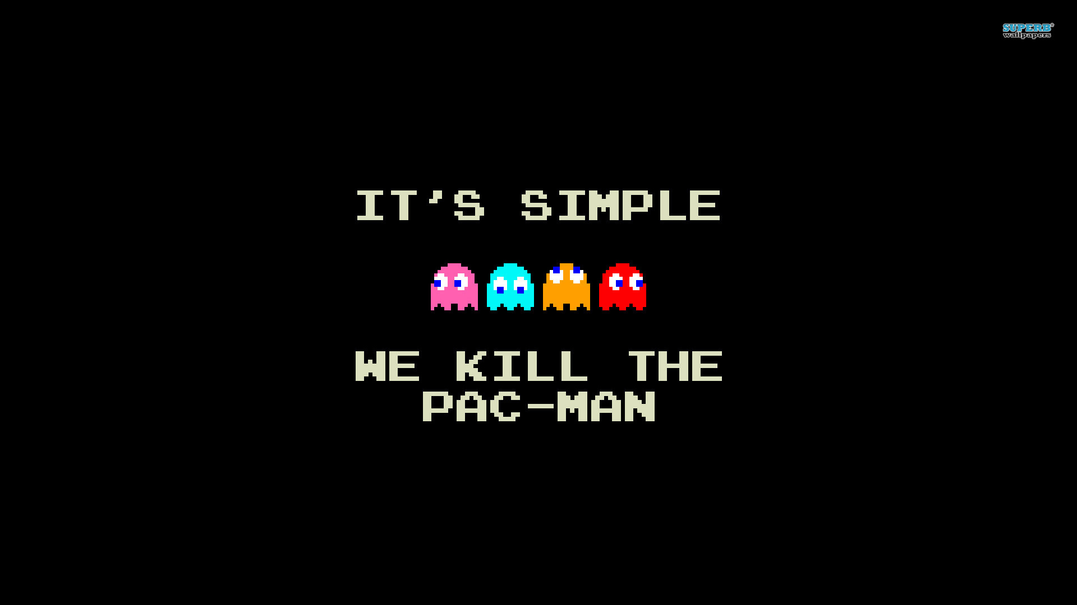

Slide 12
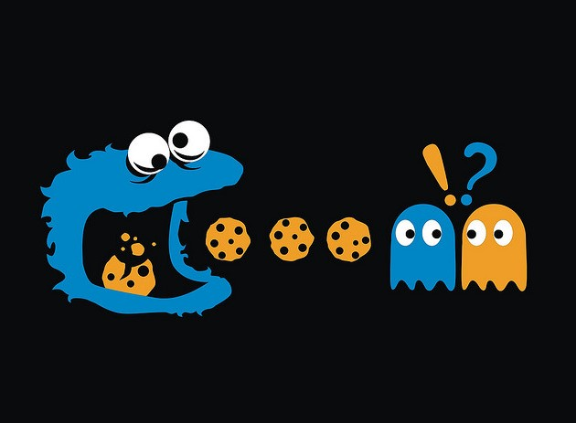

Slide 13
